Slide 1
Managing in a Global Environment
02-02-2026
Jyoti

Slide 2
Societal environment –
STEEP/ PESTEL Analysis
Societal environment- It is mankind’s social system that includes general forces that do not directly touch on the short-run activities of the organization that can, and often do, influence its long-run decisions. These factors affect multiple industries and are as follows:
  Economic factors: that regulate the exchange of materials, money, energy, and information.
  Technological factors: that generate problem-solving inventions
  Political-legal factors: that allocate power and provide constraining and protecting laws and regulations.
  Socio-cultural factors: that regulate the values and customs of society.

Slide 3
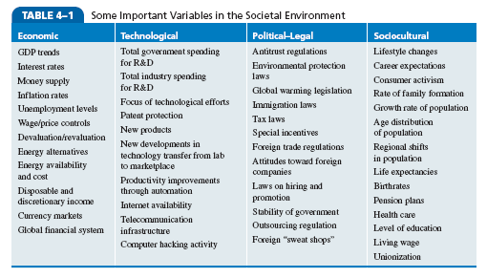
Some important variables in
Societal Environment:

Slide 4
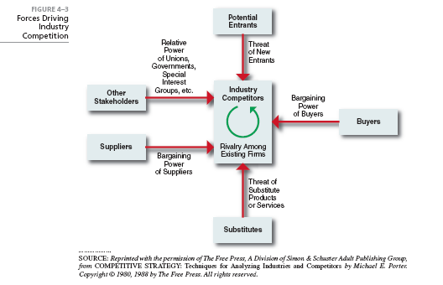
Industry Analysis:
Porter’s 5 Force Analysis

Slide 5
How Organizations Go International/Global?
Notes:
Another way to view social involvement and economic performance is by looking at socially responsible investing (SRI) funds, which provide a way for individual investors to support socially responsible companies. Typically, these funds use some type of social screening; that is, they apply social and environmental criteria to investment decisions.
SRI funds usually will not invest in companies involved in liquor, gambling, tobacco, nuclear power weapons, price fixing, fraud, or in companies that have poor product safety, employee relations, and environmental track records

Slide 6
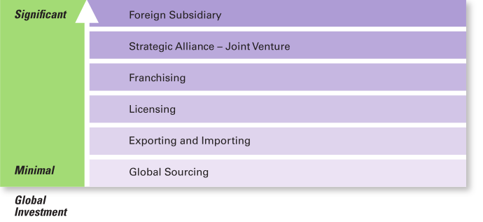
How Organizations Go International/Global
Notes:
The concept of social responsibility has been described in different ways. For instance, it’s been called “profit making only,” “going beyond profit making,” “any discretionary corporate activity intended to further social welfare,” and “improving social or environmental conditions.” We can understand it better if we first compare it to two similar concepts: social obligation and social responsiveness. Social obligation is when a firm engages in social actions because of its obligation to meet certain economic and legal responsibilities. The organization does what it’s obligated to do and nothing more. This idea reflects the classical view of social responsibility, which says that management’s only social responsibility is to maximize profits. The most outspoken advocate of this approach is economist and Nobel laureate Milton Friedman. He argued that managers’ primary responsibility is to operate the business in the best interests of the stockholders, whose primary concerns are financial.

Slide 7
Going Global: Exporting and Importing
Exporting: making products domestically and selling them abroad
  Importing: acquiring products made abroad and selling them domestically
Notes:
The other two concepts—social responsiveness and social responsibility—reflect the socioeconomic view, which says that managers’ social responsibilities go beyond making profits to include protecting and improving society’s welfare. This view is based on the belief that corporations are not independent entities responsible only to stockholders, but have an obligation to the larger society. Organizations around the world have embraced this view as shown by a survey of global executives in which 84 percent said that companies must balance obligations to shareholders with obligations to the public good.
Social responsiveness is when a company engages in social actions in response to some popular social need. Managers are guided by social norms and values and make practical, market-oriented decisions about their actions. For instance, Ford Motor Company became the first automaker to endorse a federal ban on sending text messages while driving.
A socially responsible organization goes beyond what it’s obligated to do or chooses to do because of some popular social need and does what it can to help improve society because it’s the right thing to do. We define social responsibility as a business’s intention, beyond its legal and economic obligations, to do the right things and act in ways that are good for society. A socially responsible organization does what is right because it feels it has an ethical responsibility to do so.

Slide 8
Going Global: Licensing and Franchising
Licensing: an organization gives another organization the right to make or sell its products using its technology or product specifications
  Franchising: an organization gives another organization the right to use its name and operating methods
Notes:
The other two concepts—social responsiveness and social responsibility—reflect the socioeconomic view, which says that managers’ social responsibilities go beyond making profits to include protecting and improving society’s welfare. This view is based on the belief that corporations are not independent entities responsible only to stockholders, but have an obligation to the larger society. Organizations around the world have embraced this view as shown by a survey of global executives in which 84 percent said that companies must balance obligations to shareholders with obligations to the public good.
Social responsiveness is when a company engages in social actions in response to some popular social need. Managers are guided by social norms and values and make practical, market-oriented decisions about their actions. For instance, Ford Motor Company became the first automaker to endorse a federal ban on sending text messages while driving.
A socially responsible organization goes beyond what it’s obligated to do or chooses to do because of some popular social need and does what it can to help improve society because it’s the right thing to do. We define social responsibility as a business’s intention, beyond its legal and economic obligations, to do the right things and act in ways that are good for society. A socially responsible organization does what is right because it feels it has an ethical responsibility to do so.

Slide 9
Going Global:
Strategic Alliances and Joint Ventures
Strategic Alliance: partnership between an organization and foreign company partner(s) in which both share resources and knowledge
in developing new products or building production facilities
  Joint Venture: A specific type of strategic alliance in which the partners agree to form a separate, independent organization for some business purpose
Notes:
Until the late 1960s, few people (and organizations) paid attention to the environmental consequences of their decisions and actions. However, a number of environmental disasters brought a new spirit of environmentalism to individuals, groups, and organizations. Increasingly, managers have begun to consider the impact of their organization on the natural environment, which we call green management.

Slide 10
Going Global: Foreign Subsidiary
Foreign Subsidiary: directly investing in a foreign country by setting up a separate and independent production facility or office
Notes:
Managers and organizations can do many things to protect and preserve the natural environment. Some do no more than what is required by law; that is, they fulfill their social obligation. The first approach, the legal (or light green) approach, is simply doing what is required legally. In this approach, which illustrates social obligation, organizations exhibit little environmental sensitivity. They obey laws, rules, and regulations without legal challenge and that’s the extent of their being green.
As an organization becomes more sensitive to environmental issues, it may adopt the market approach and respond to environmental preferences of customers. Whatever customers demand in terms of environmentally friendly products will be what the organization provides.
In the stakeholder approach, an organization works to meet the environmental demands of multiple stakeholders such as employees, suppliers, or community.
Finally, if an organization pursues an activist (or dark green) approach, it looks for ways to protect the earth’s natural resources. The activist approach reflects the highest degree of environmental sensitivity and illustrates social responsibility.

Slide 11
Thank you

